Slide 1

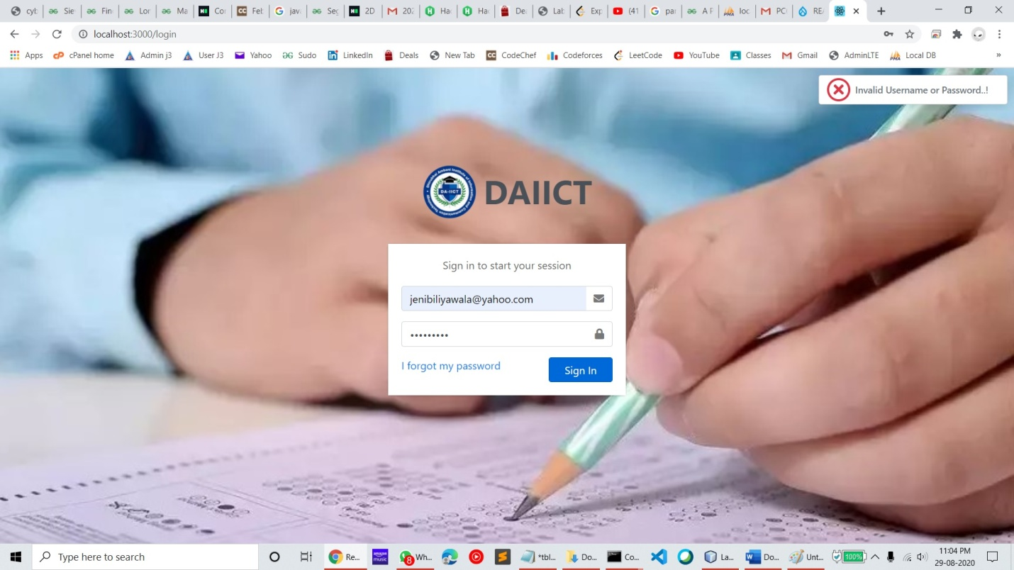
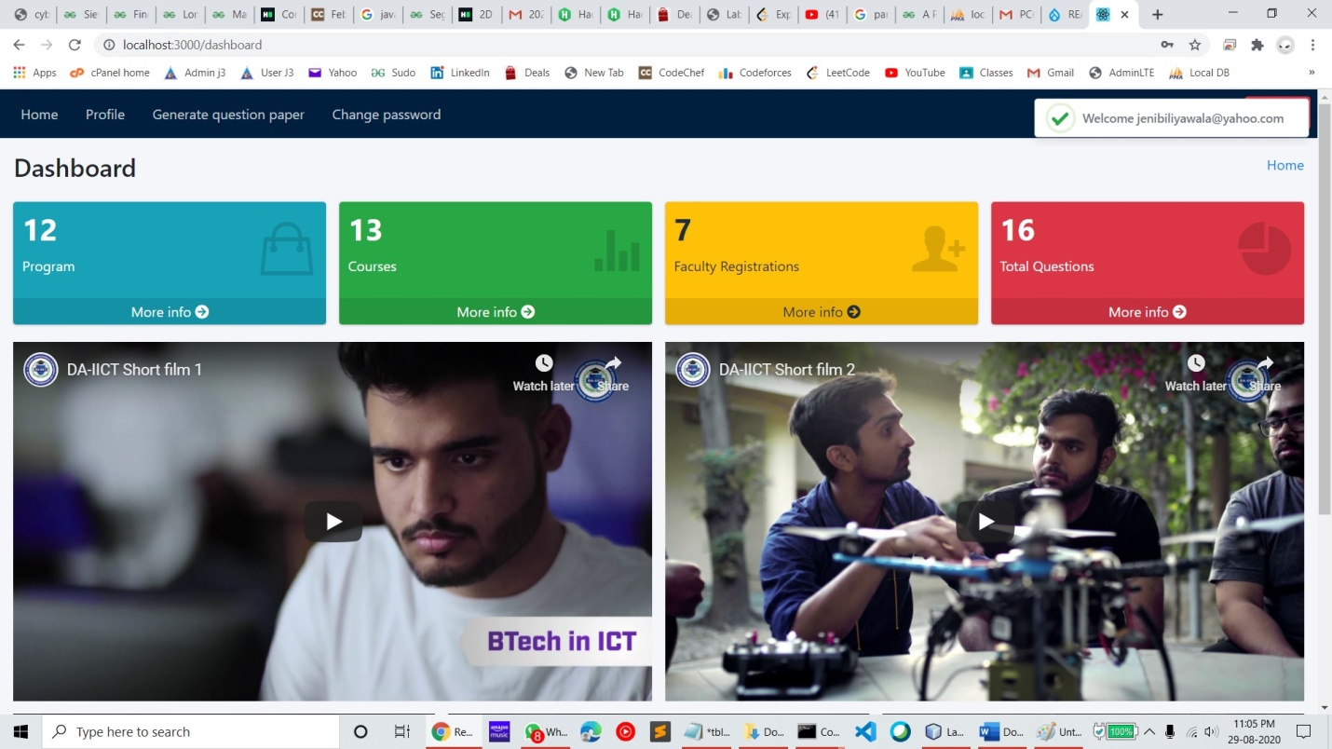
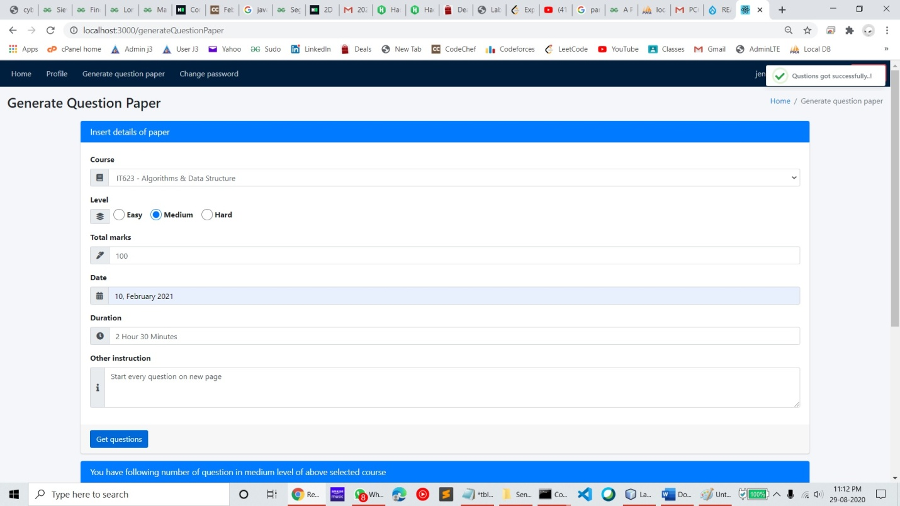
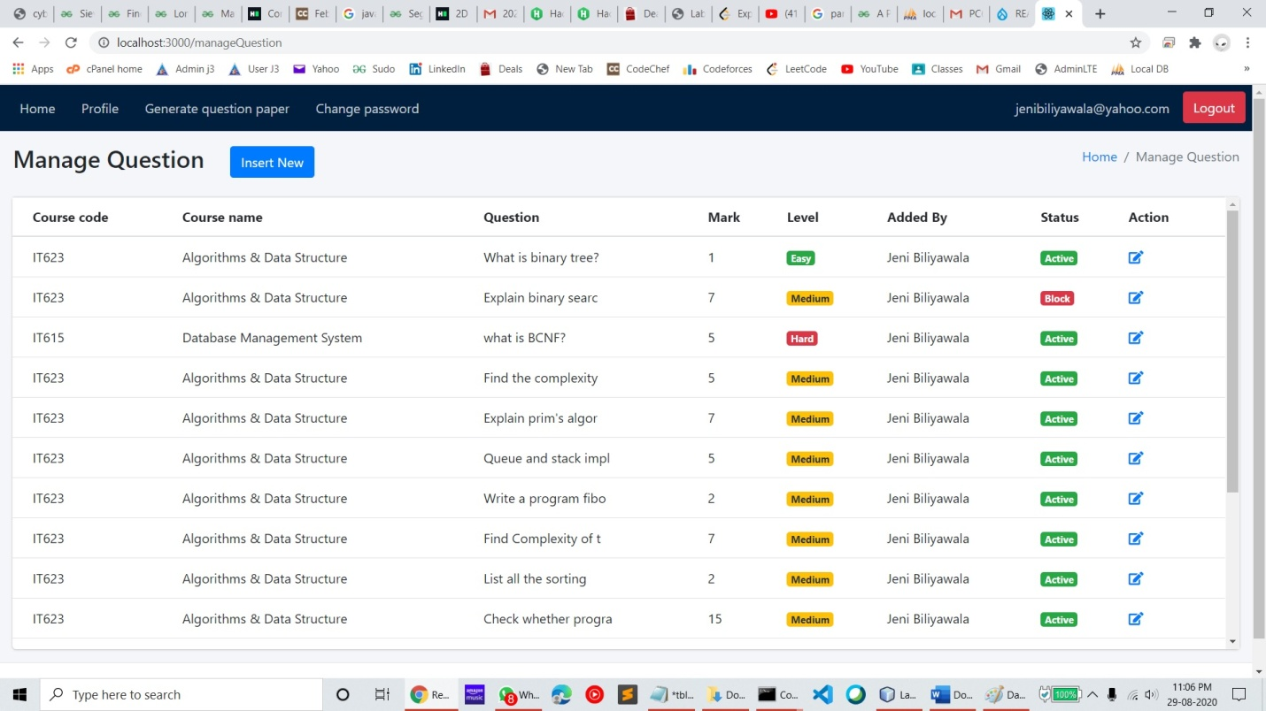
PC649: MSc (IT) Summer Internship
QUESTER
Jeni Biliyawala, Vasani Vibhuti
201912089
201912110
Dr. Shruti Bhilare
ABOUT THE PROJECT
SOFTWARE DESIGN
Project is intended for automating the process of generating test question papers. Parameterising the marks, their weightage and test paper difficulty level for generating a question paper; having a question bank and repository of all courses across programs for different faculties are the core responsibilities. Surrounding features such as authentication, managing user profile etc are provided to ease the service maintenance.
SNAPSHOTS

